Slide 1


Sign Language Detection System Using ML and DL
This presentation outlines the development of a sign language detection system using machine learning and deep learning techniques. The system will aim to accurately interpret and translate sign language into spoken language or text, facilitating communication between deaf and hearing communities.
by Sahil Giri

Slide 2
Introduction to Sign Language
Sign language is a visual language that uses hand gestures, facial expressions, and body movements to convey meaning.
Each sign language is unique, with its own alphabet, grammar, and cultural context.

Slide 3

Challenges in Sign Language Recognition
Hand Variability
Background Noise
Sign Language Diversity
Hand size, shape, and movement vary between individuals, making recognition challenging.
Distracting background elements can interfere with accurate sign detection.
Different sign languages have unique gestures and grammar, requiring specialized models.

Slide 4
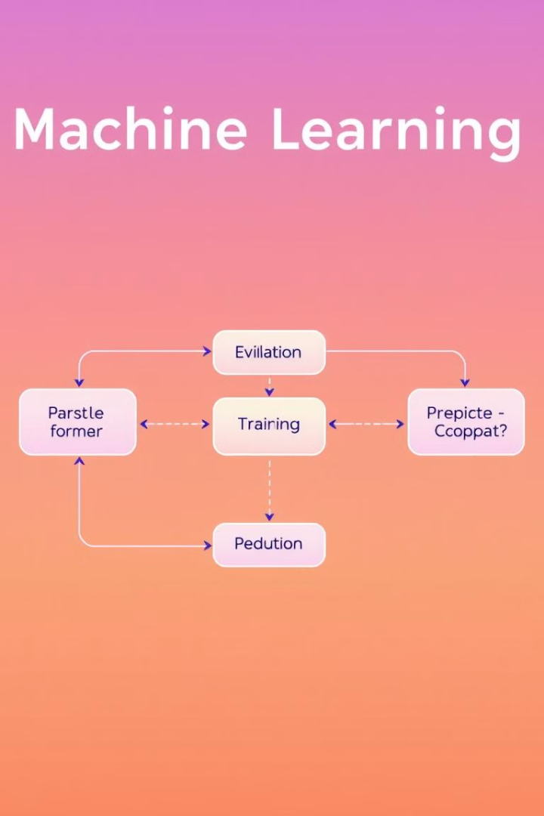
Machine Learning Approach
Data Collection
Feature Extraction
Gather a large dataset of signed language images.
Identify key features of each sign, such as hand shape, position, and movement.
Model Training
Prediction
Train a machine learning model to recognize patterns in the extracted features.
Use the trained model to classify new signs based on their features.

Slide 5




Deep Learning Techniques
Convolutional Neural Networks (CNNs)
Recurrent Neural Networks (RNNs)
Excellent for image and video processing, CNNs can learn spatial features of signs.
RNNs are suitable for recognizing temporal patterns in sign language, such as sign sequences.
Long Short-Term Memory (LSTM)
A specialized RNN variant, LSTM networks can remember long-term dependencies in sign language.

Slide 6
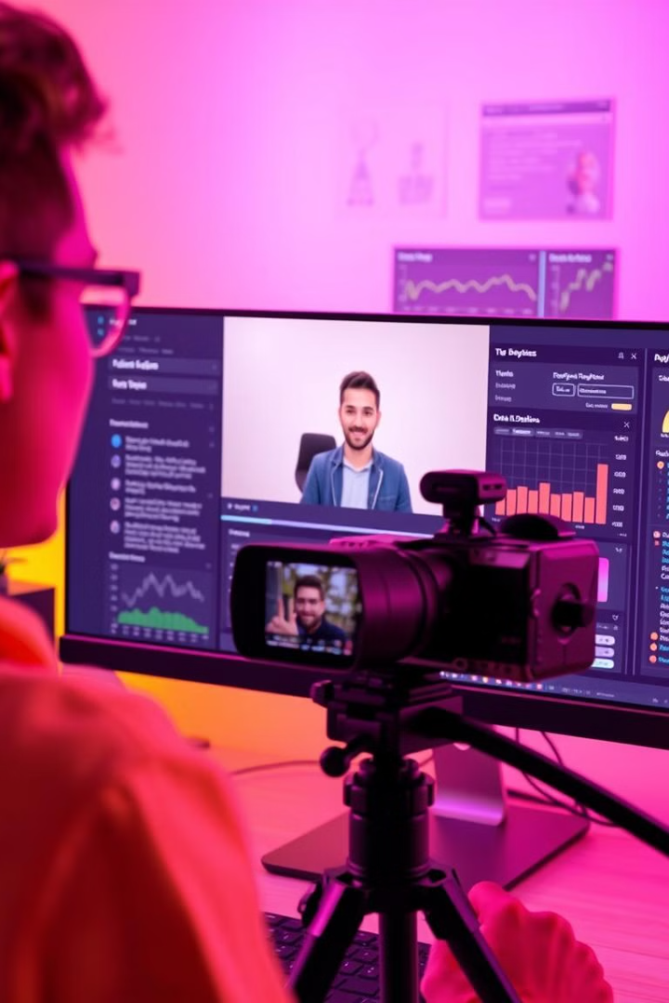
Data Collection and Preprocessing
1
Record high-quality videos of signers performing a wide range of signs.
2
Segment videos into individual signs, labeling each with its corresponding meaning.
3
Clean the data, removing noise and artifacts that could hinder model accuracy.

Slide 7




Model Training and Evaluation
Model Selection
1
Choose a suitable deep learning architecture based on the complexity of the task.
Training
2
Train the model on the preprocessed dataset, optimizing its parameters to minimize error.
Evaluation
3
Assess the model's performance on a separate test dataset, measuring accuracy and generalization.
Refinement
4
Iteratively adjust the model or training process based on evaluation results.

Slide 8

Real-Time Sign Language Detection and Applications
1
2
Accessibility
Education
Enable real-time communication for deaf individuals in various settings.
Support deaf students by providing a visual way to learn and interact with content.
3
Healthcare
Facilitate communication between deaf patients and healthcare professionals.

